Slide 1

Breaking Bias
Housing prices of Ames

Slide 2
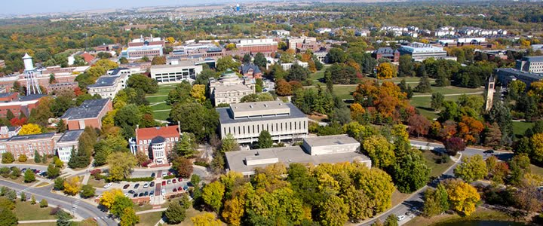
The Great Mystery
Which model/models
With what features/predictors
Best predict the housing prices of Ames, Iowa

Slide 3
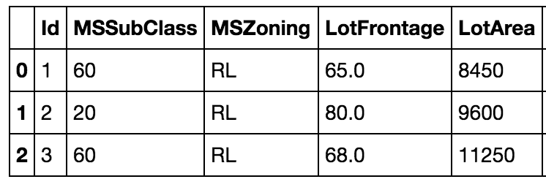
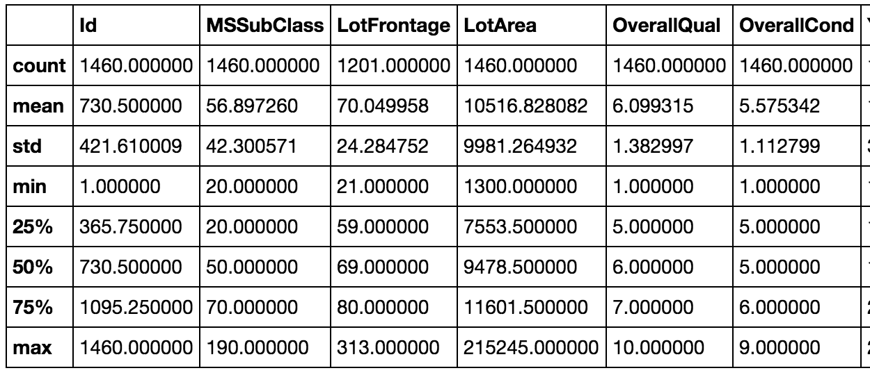
Peek on Data Set
Data size
row column
train 1460 81
test 1459 80
Data types
object 43
int64 26
float64 12
Variable Names
[‘MSSubClass’, ‘MSZoning’, ‘LotFrontage’, ‘LotArea’, ‘Street’, ...]
Data head
Data summary

Slide 4
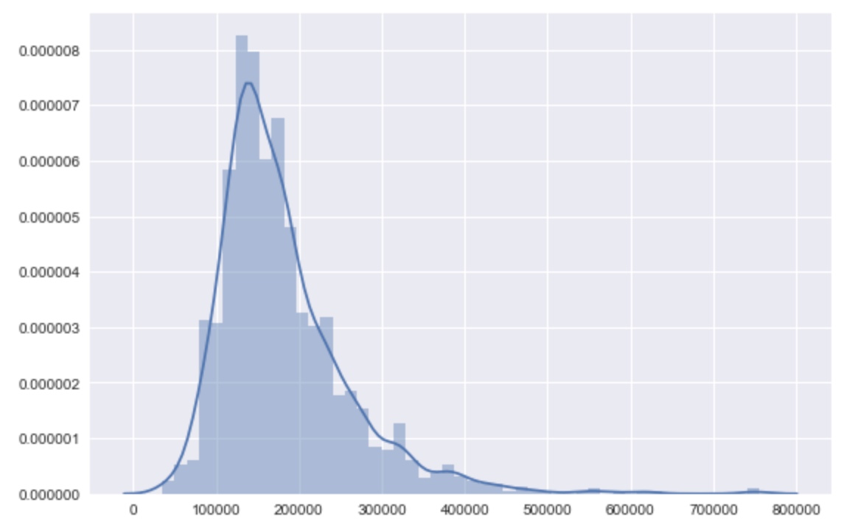
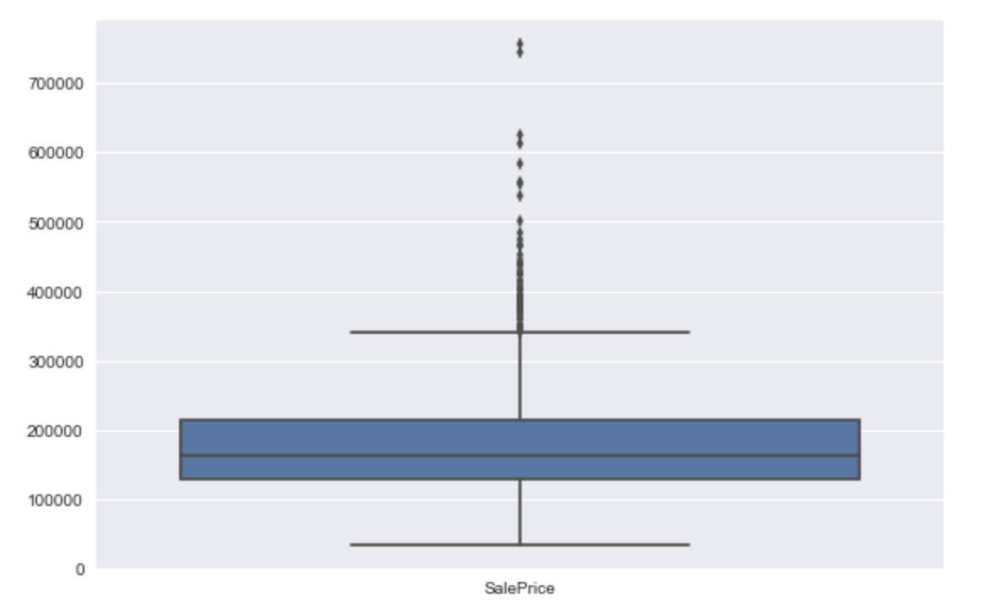
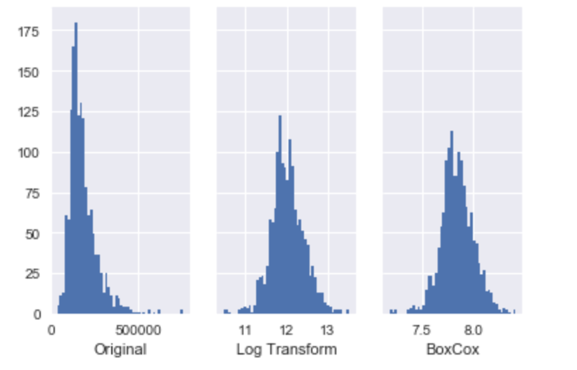
What does Y(SalePrice) look like?

Slide 5
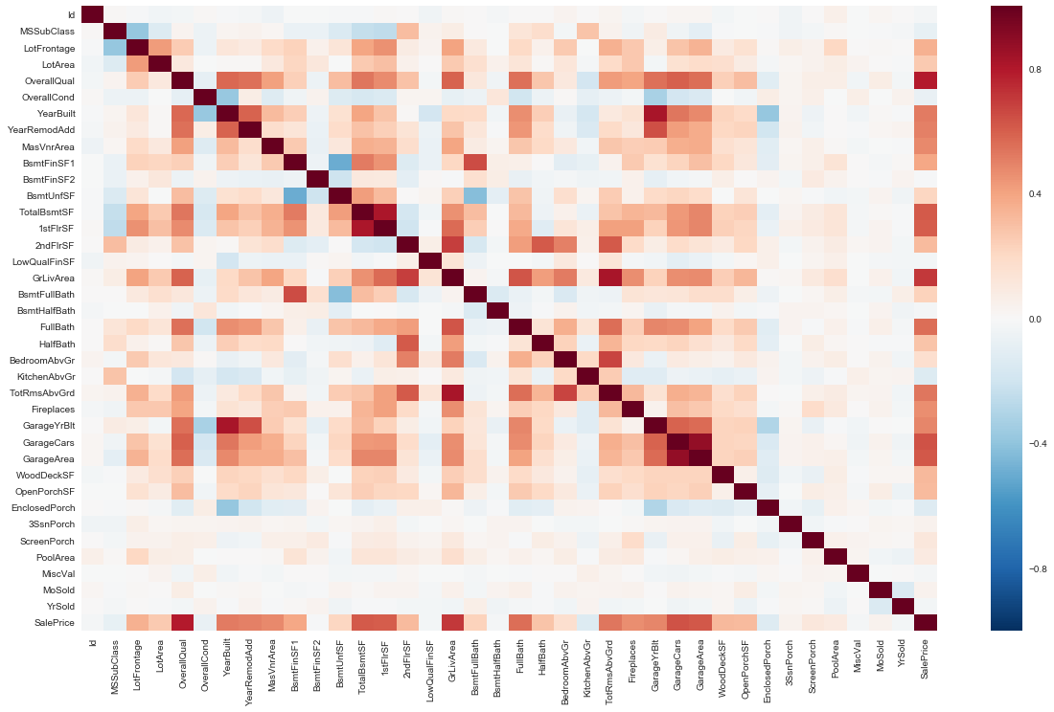
Most Related Features
Garage Cars
~
Garage Area
YearBuilt
~
GarageYrBlt
1stFlrSF
~
TotalBsmtSF
Most related to Y
SalePrice
~
OverallQual
SalePrice
~
GrLivArea
Correlation of all numerical features

Slide 6
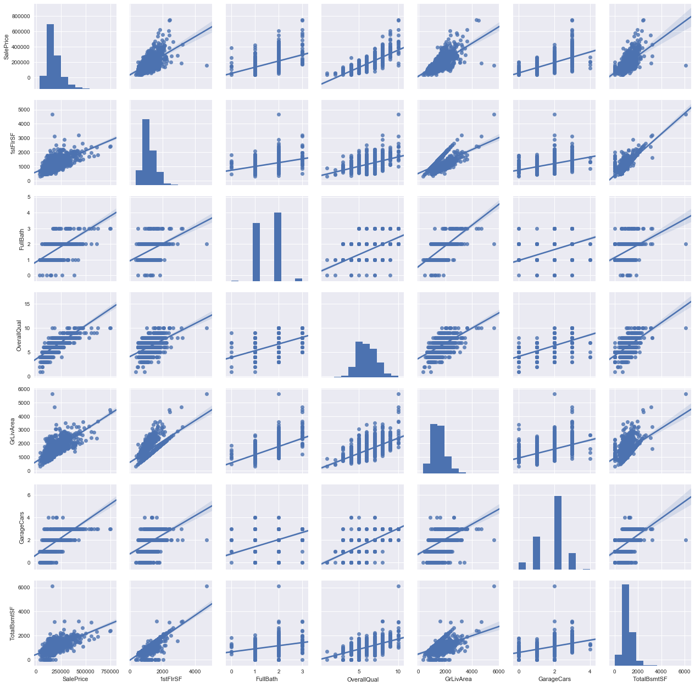
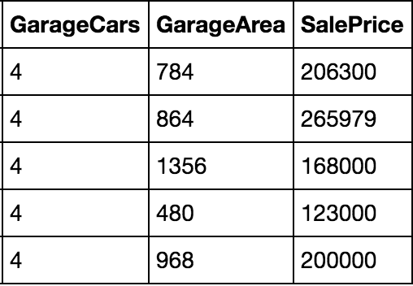
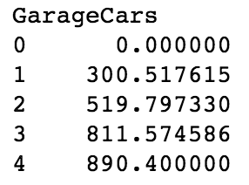
More explore on most related features
-- Linear
-- Variance
-- Normality / Skewness (need to log?)
What we found?
-- strong linear between some features
Have questions?
-- 4 cars garage prices?
mean

Slide 7
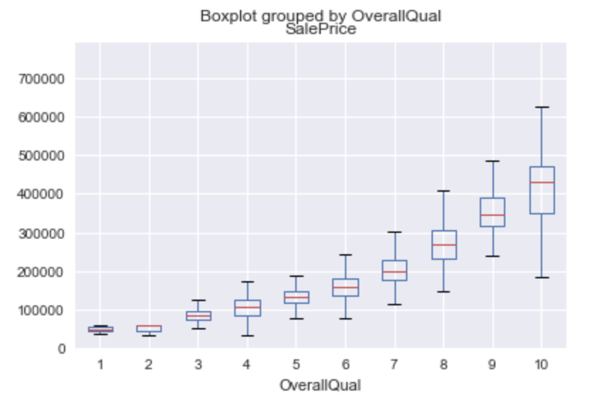
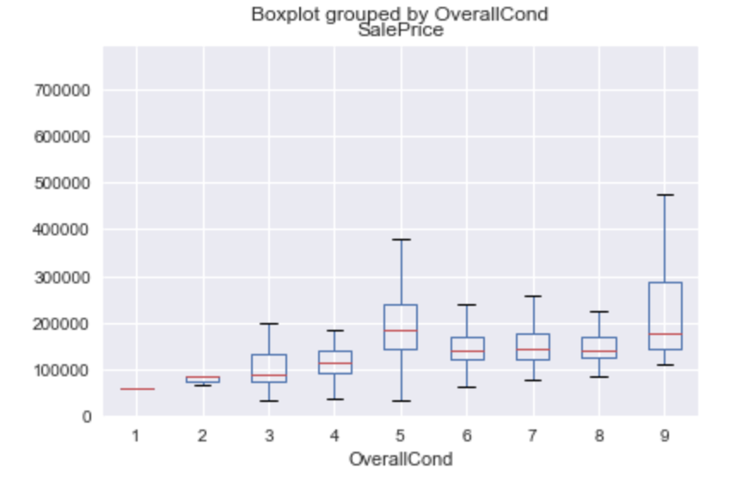
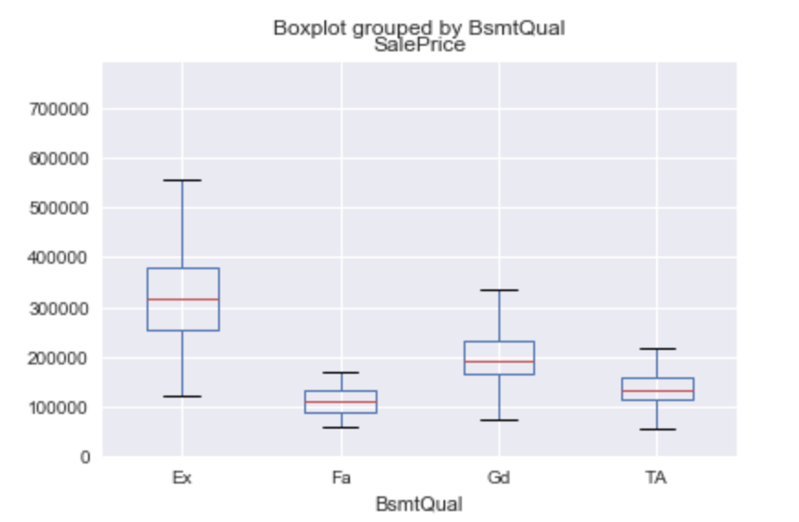
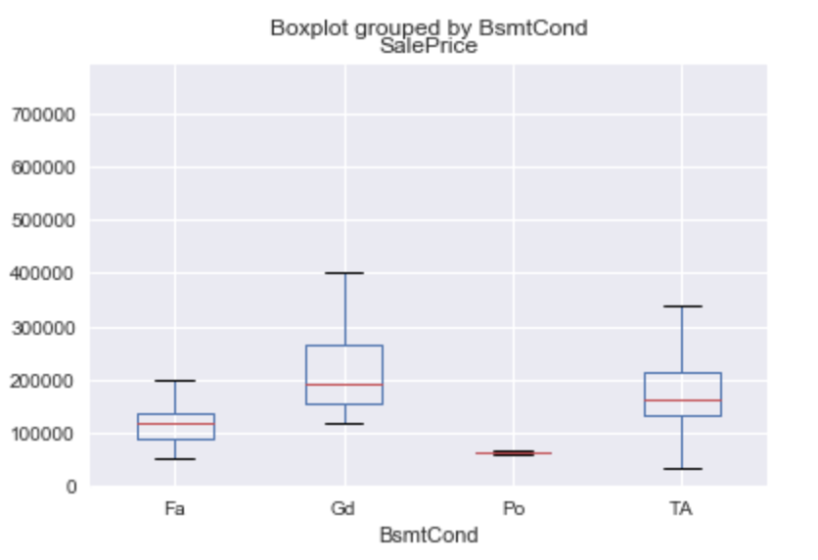
Some related features (boxplot)

Slide 8
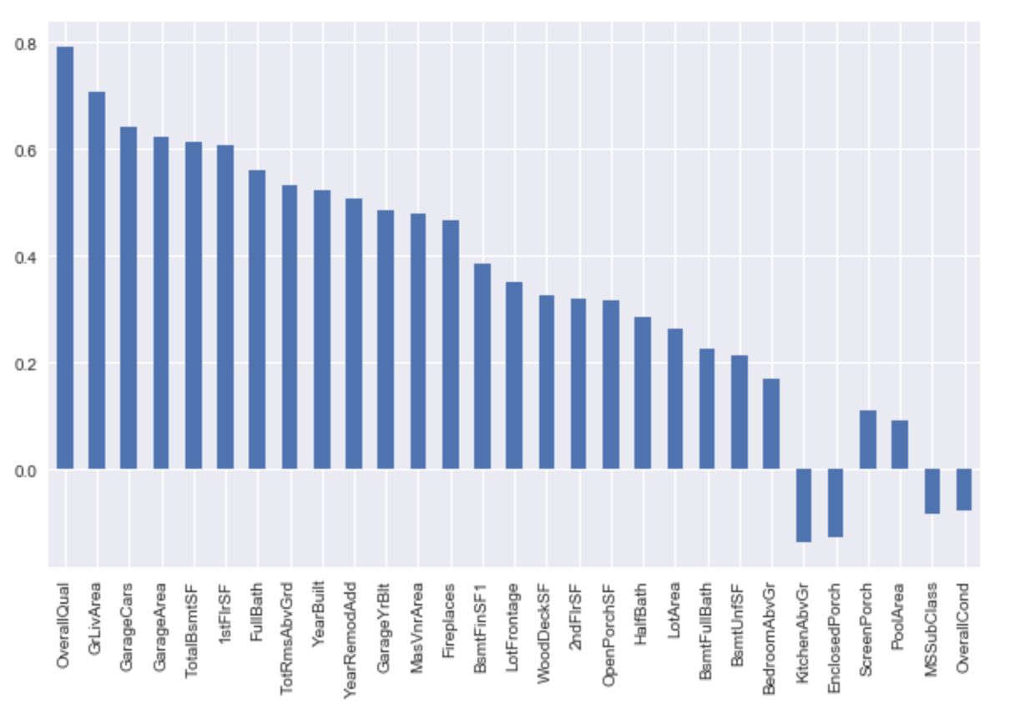
Sorted features by Corr with Y(HousePrice)
-Relationship between X and Y?
↵

Slide 9
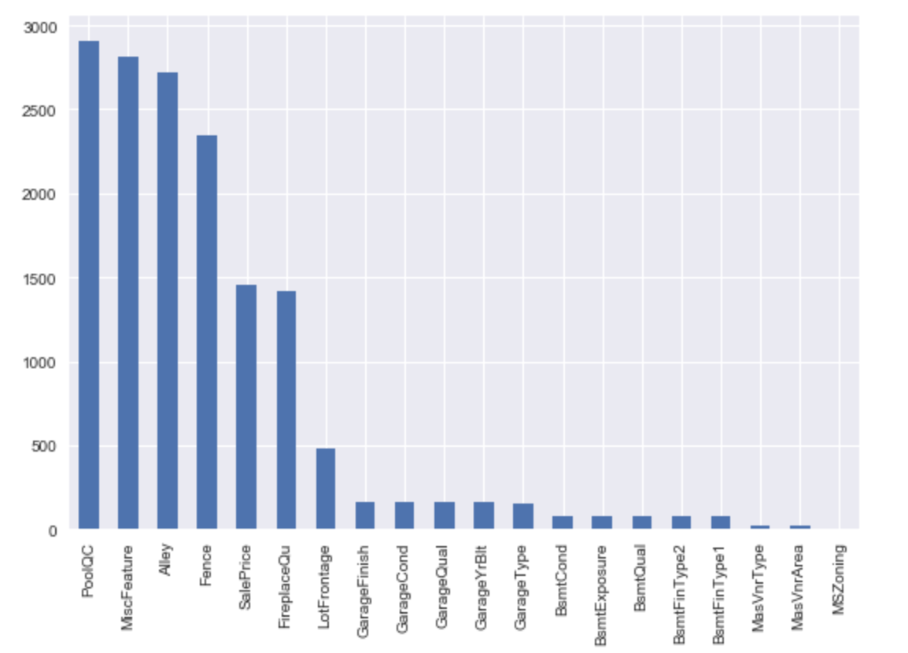
Missing Data Visualization
Why so many missing data?
->
Check data description

Slide 10
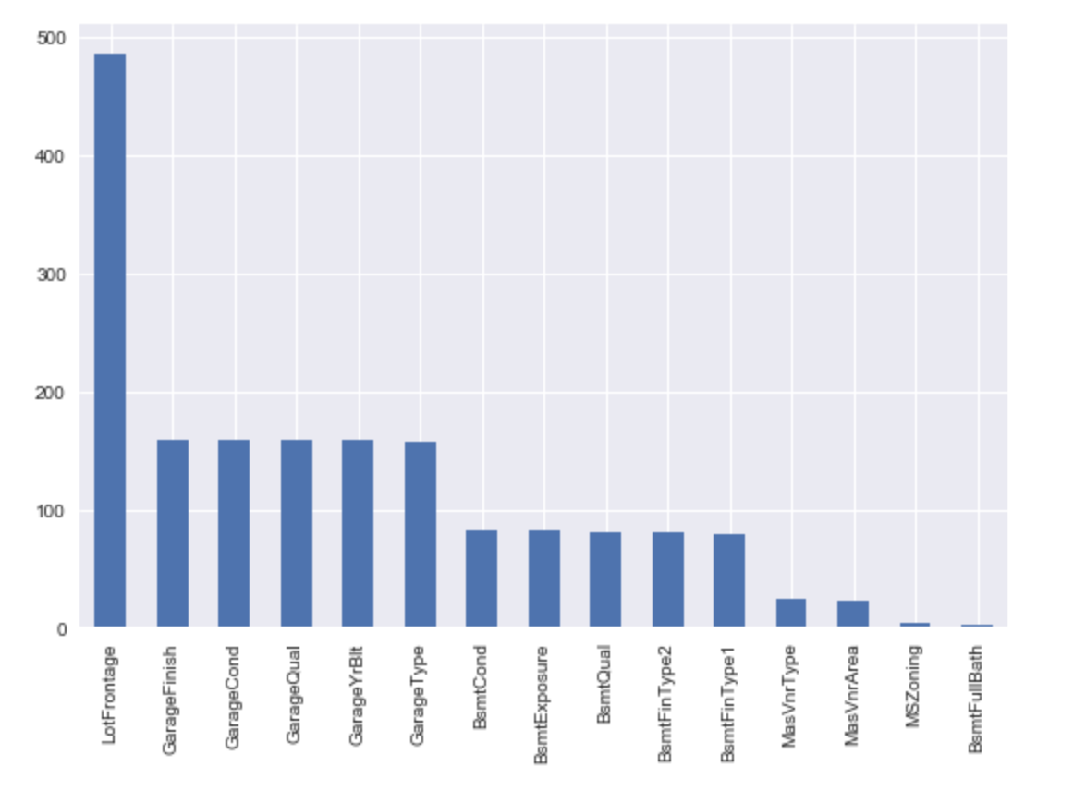
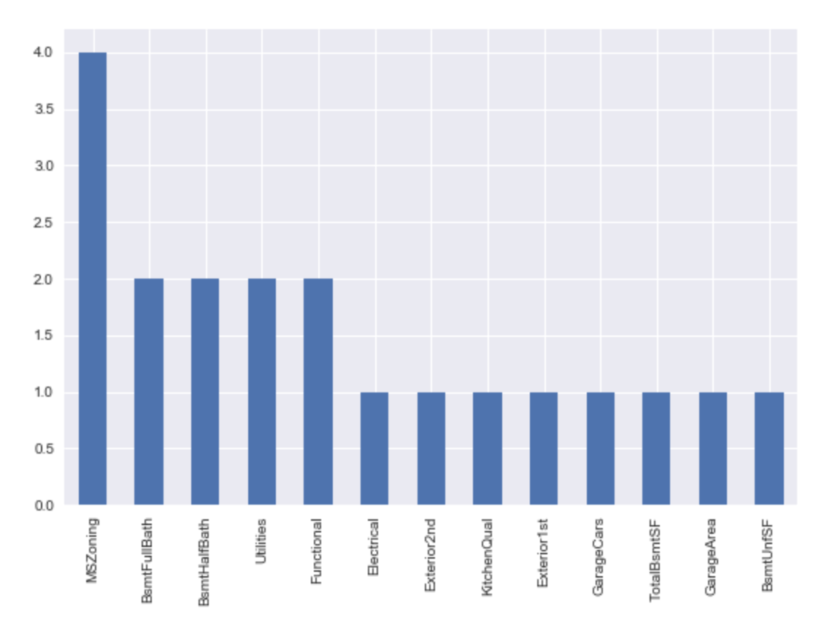
More about missing data!
Attention!
Scale

Slide 11
Initial Cleaning / Imputing
Many columns have missing values, and not all can be treated the same way
Some are missing because they are just not applicable to the house in question (e.g. columns giving info about fireplaces/pools/garages for houses which do not have those things)
Some just seem not to have been recorded, and it makes sense to impute them with the mean or median of the column
Treat years as numerical, but this is an interesting question to think about

Slide 12
Initial Cleaning / Imputing
A number of columns have a high skewness, including the important SalePrice column from the training data
We transformed these columns by the transformation f(x) = log(x + 1) to reduce skew, transforming SalePrice back at the end to get the predicted price
Skew was lessened by this transformation so the assumptions for regression were closer to being fulfilled.

Slide 13
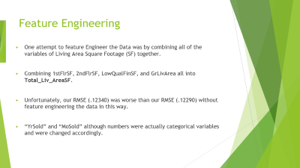
Feature Engineering
One attempt to feature Engineer the Data was by combining all of the variables of Living Area Square Footage (SF) together.
Combining 1stFlrSF, 2ndFlrSF, LowQualFinSF, and GrLivArea all into Total_Liv_AreaSF.
Unfortunately, our RMSE (.12340) was worse than our RMSE (.12290) without feature engineering the data in this way.
“YrSold” and “MoSold” although numbers were actually categorical variables and were changed accordingly.
Notes:
Along with imputing/cleaning there were multiple ways we attempted to Feature Engineer the data.

Slide 14
Ridge Model
Why Ridge
-The main idea behind our group using Ridge Regression was because of the model’s ability to alleviate Multiple Collinearity.
-Adds a small bias factor to the variables in order to alleviate this problem.
Alpha = 10 is best
RMSE = .12623

Slide 15
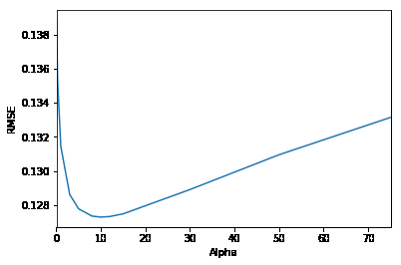
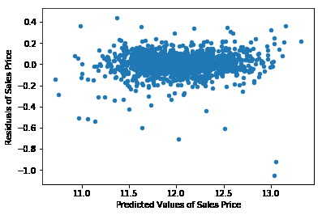
Ridge model

Slide 16
Lasso Model
Lasso model is useful because of its tendency to prefer solutions with fewer parameters.
The solutions are dependent on much fewer variables.
Our RMSE for our Lasso Model was 0.12290 and was our best RMSE across all of our models.

Slide 17
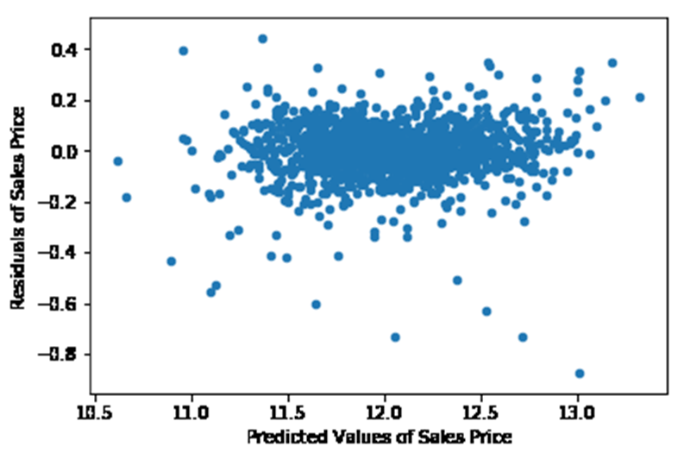
Lasso Model

Slide 18
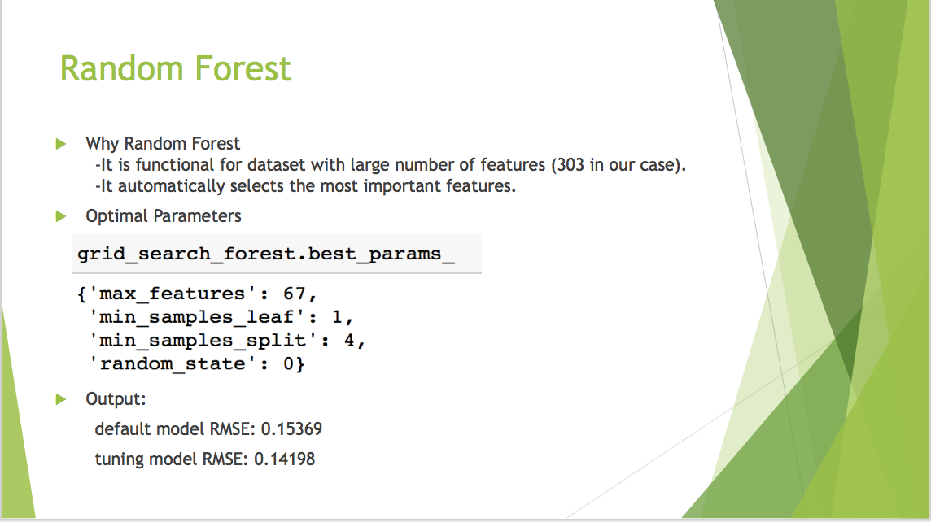

Slide 19
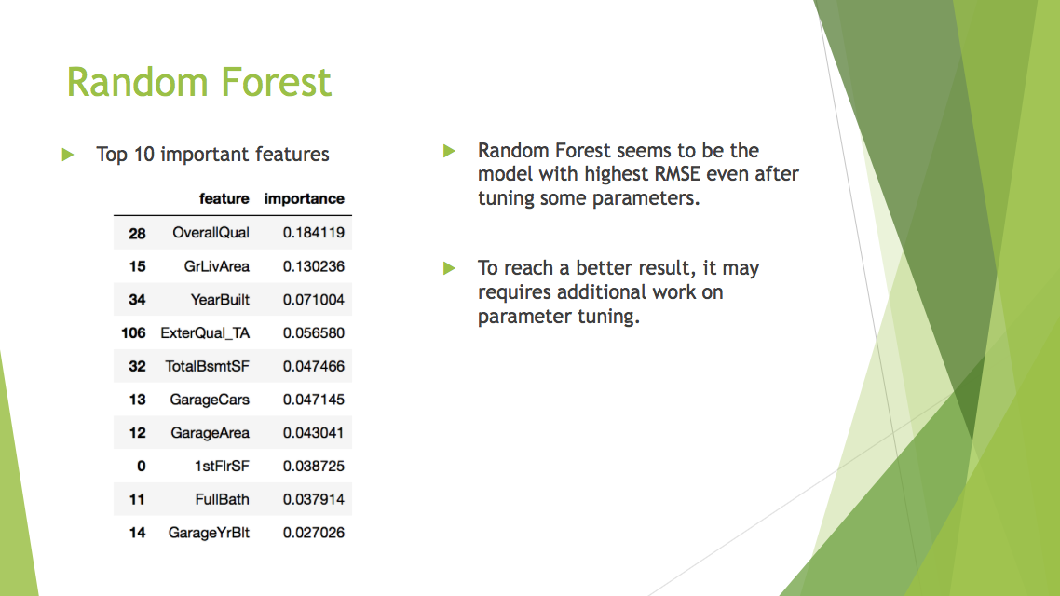

Slide 20
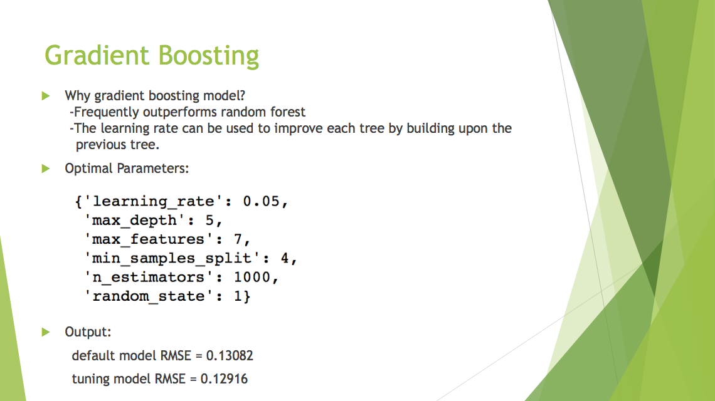

Slide 21
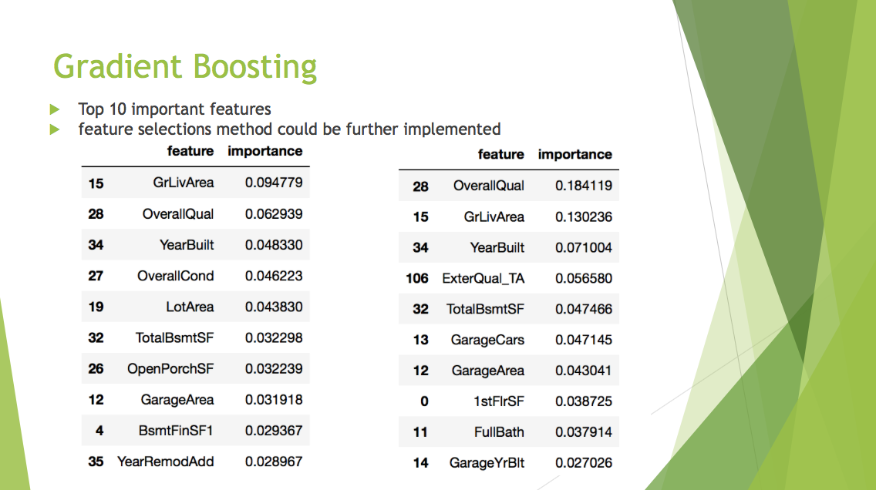

Slide 22
Conclusions
What worked:
- Our best model and score we received was with the Lasso Model.
- We received a score of 0.12290
What did not work
-Our random forest and Gradient Boosting models did not work very well and returned values much worse than our Lasso RMSE.
Why?
-This possibly happened because variables weren’t altered in ways that could have been more beneficial. Cost complexity may have contributed to the higher score. Also data could have been cleaned or imputed differently as well to give better results.

Slide 23

Future Research
Limit the number of features to reduce complexity in tree based models
Also potentially forge Principal Components to reduce complexity by reducing the number of dimensions
Try using Support Vector Machines, XGBoost, and other potentially useful models
Try stacking, bayesian optimization
Find more effective ways to feature engineer. Better understand Real Estate.

